Slide 1
Safari Zoo
Task 3

Slide 2
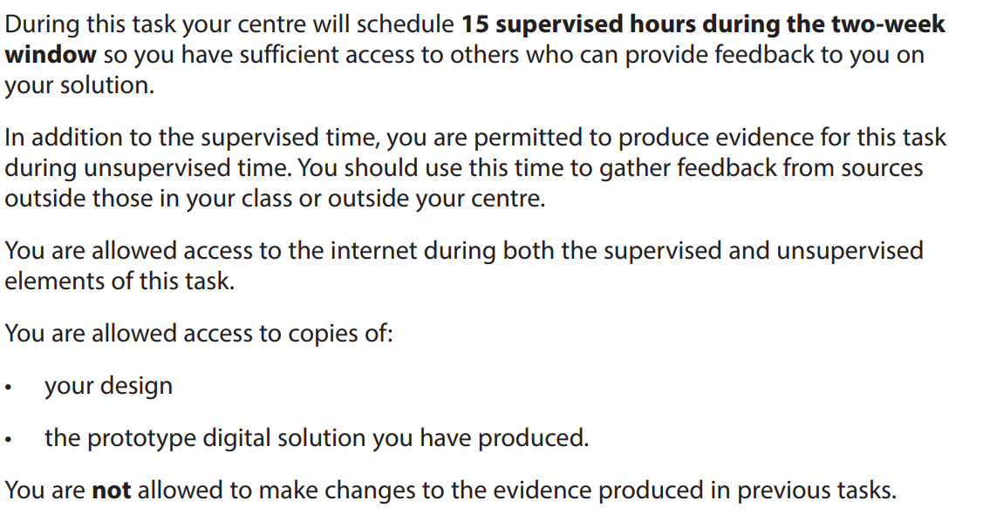

Slide 3
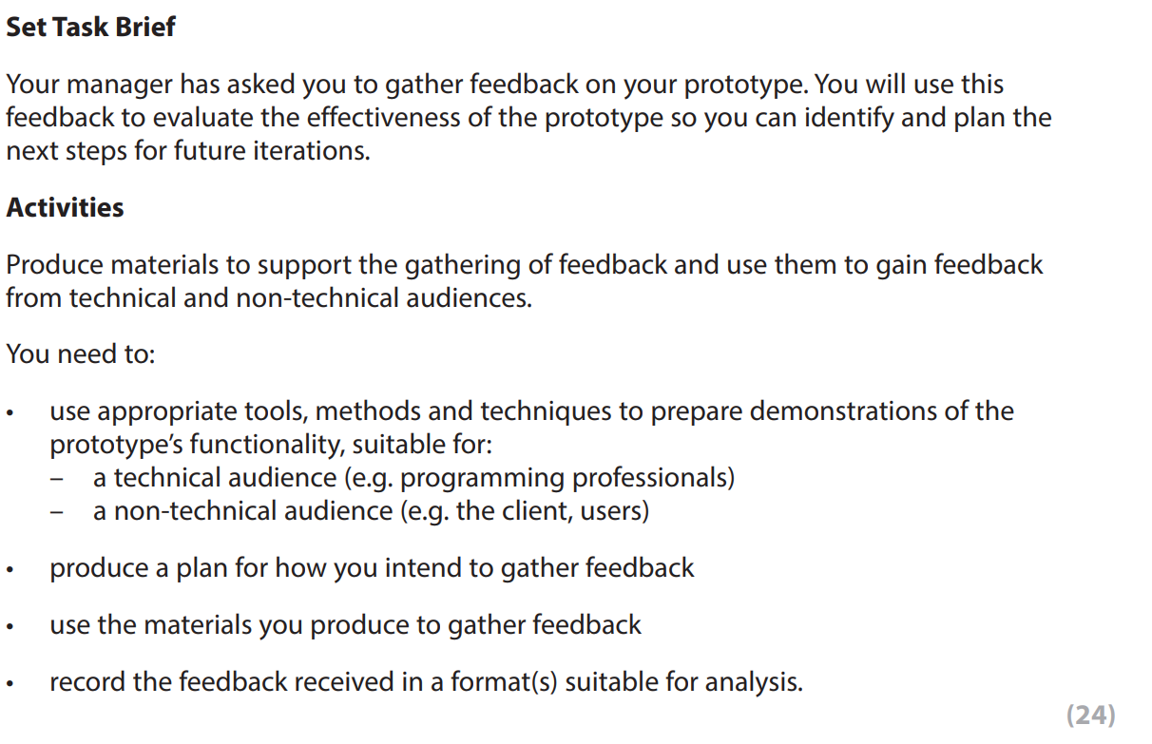

Slide 4
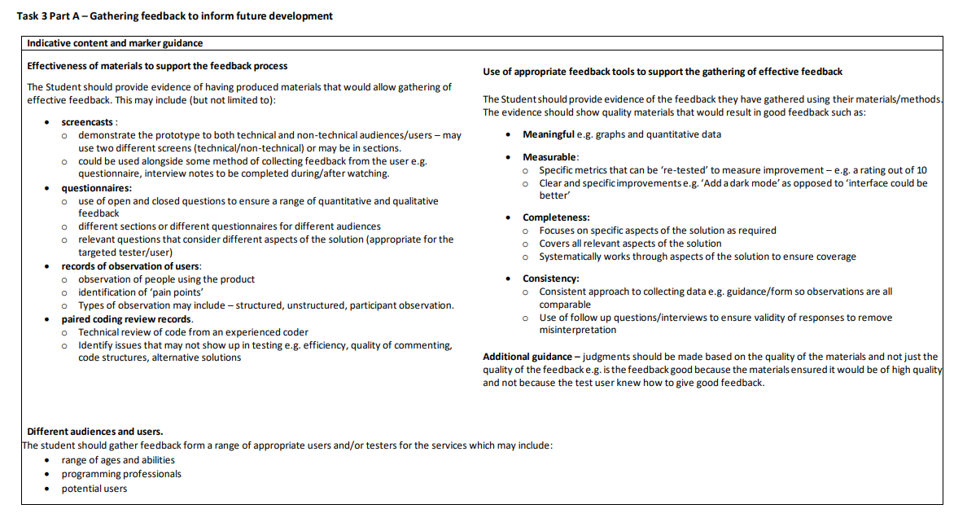

Slide 5
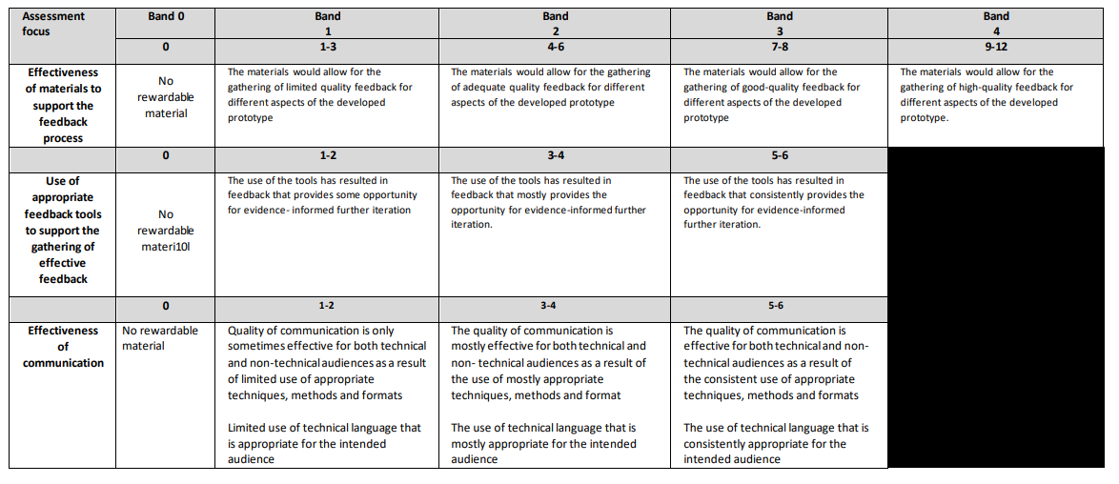

Slide 6
task 3A | effectiveness of materials to support feedback process | Feedback materials - questionnaires, meetings, observing users | 12
 | use of appropriate feedback to support gathering of effective feedback | using feedback to inform errors | 6
 | effectiveness of communication | use of technical and non-technical language to inform users of improvements made using the feedback | 6

Slide 7
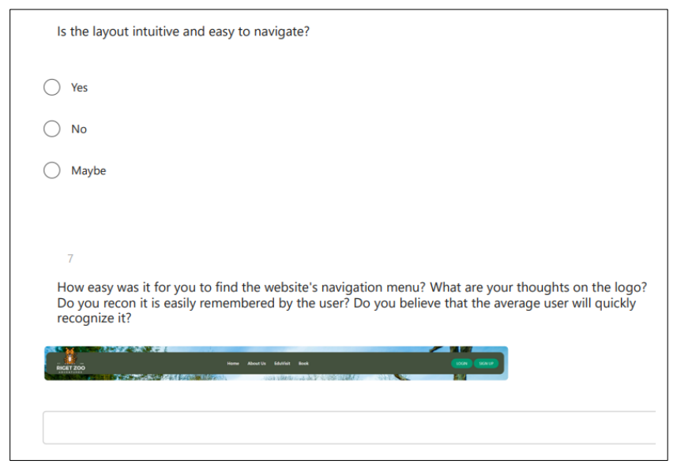

Slide 8
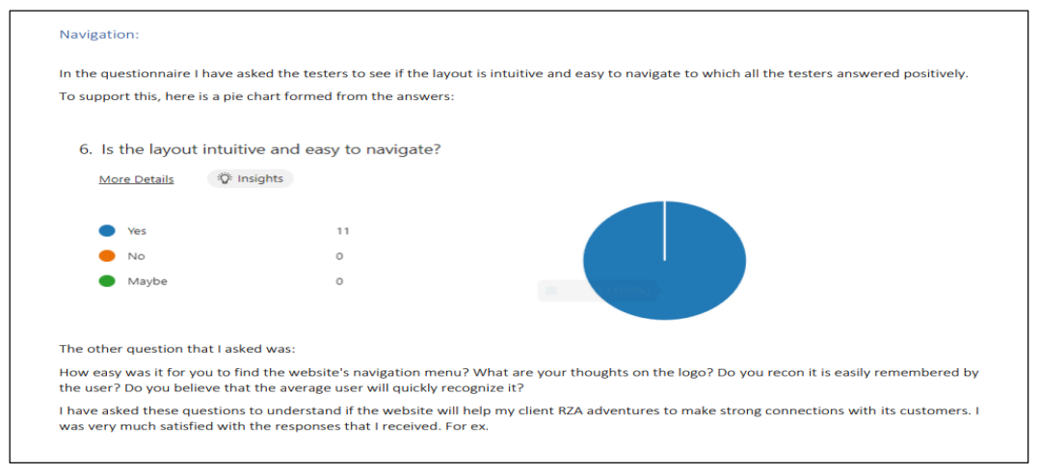

Slide 9
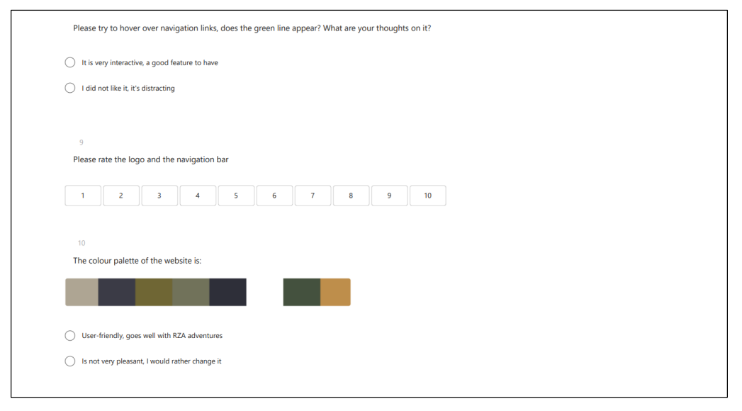

Slide 10
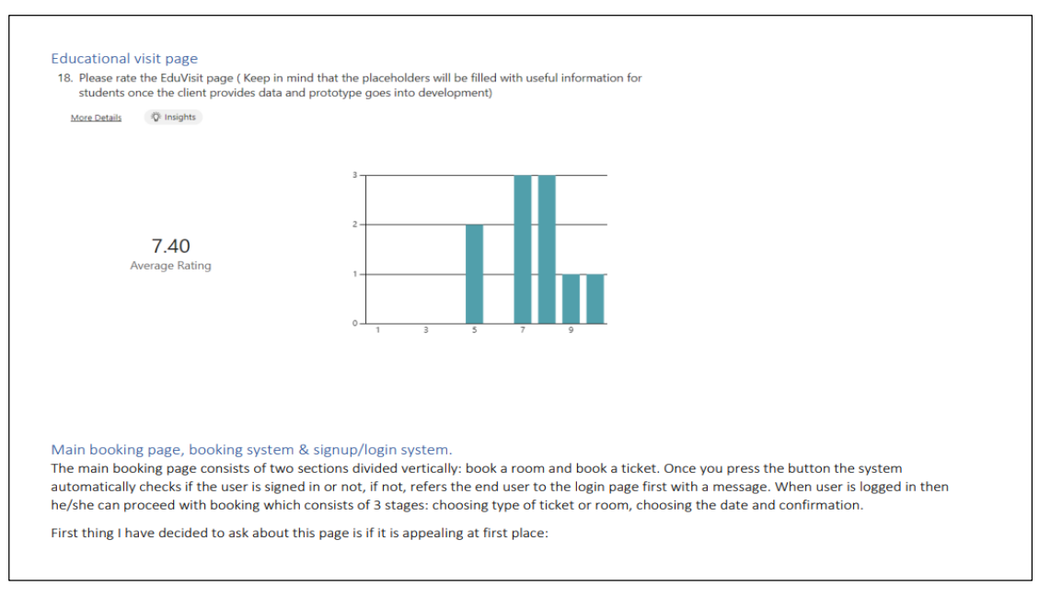

Slide 11
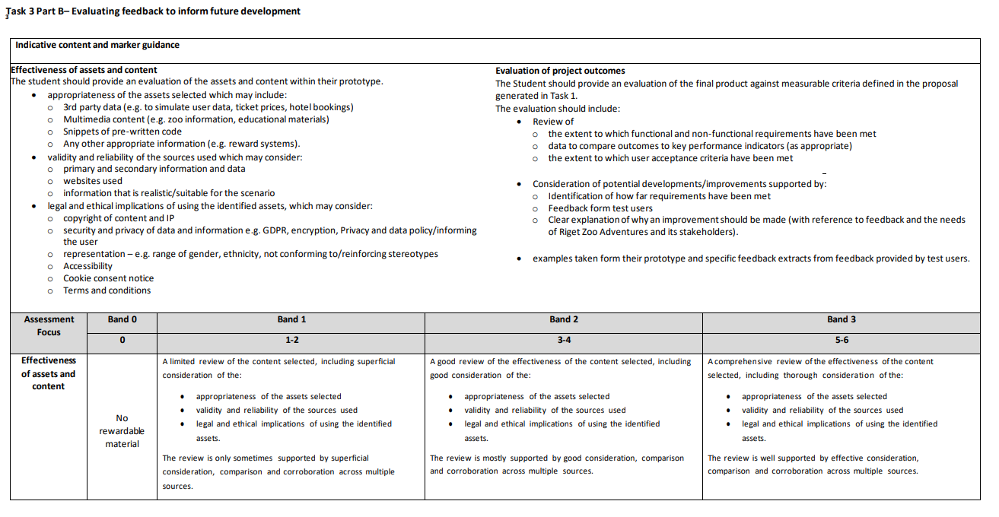
Task 3b

Slide 12
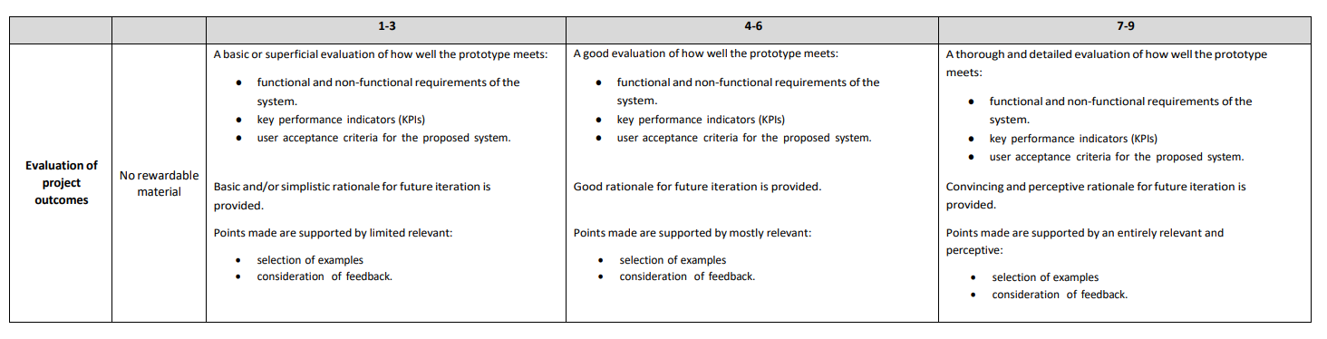
Task 3b

Slide 13
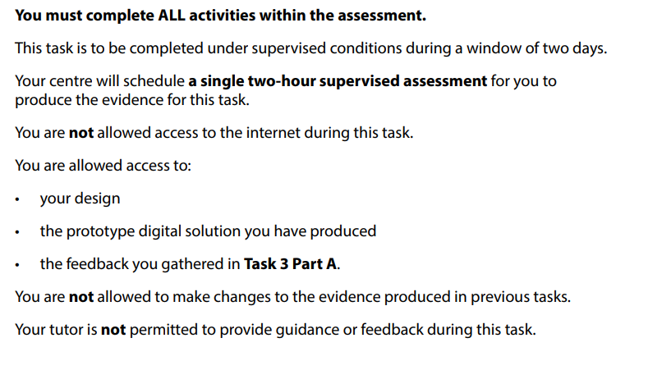
Task 3b

Slide 14
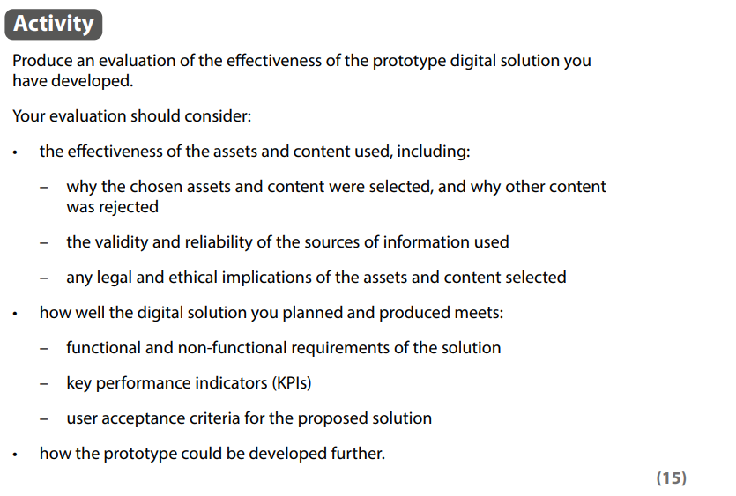
Task 3b

Slide 15
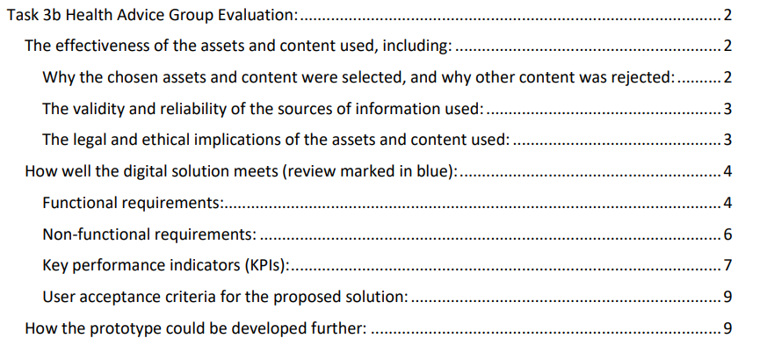

Slide 16
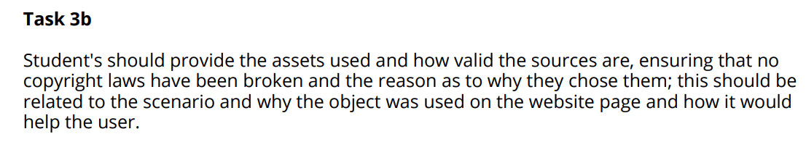
Examiners Comments

Slide 17
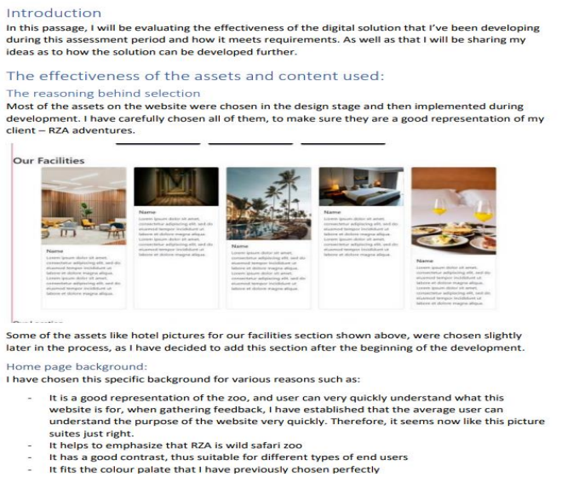

Slide 18
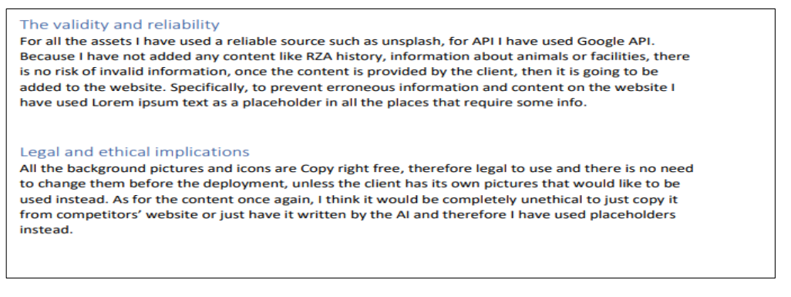
Examiners Comments

Slide 19
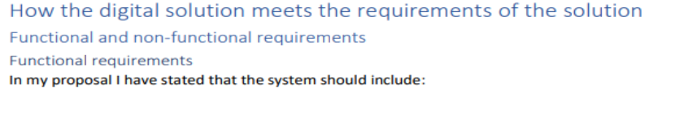
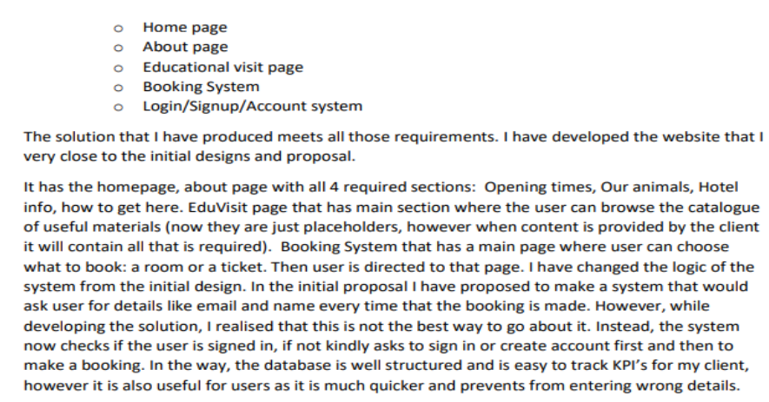

Slide 20
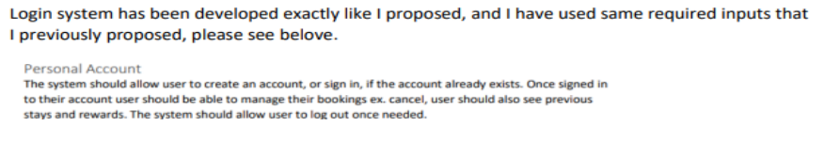
Examiners Comments

Slide 21
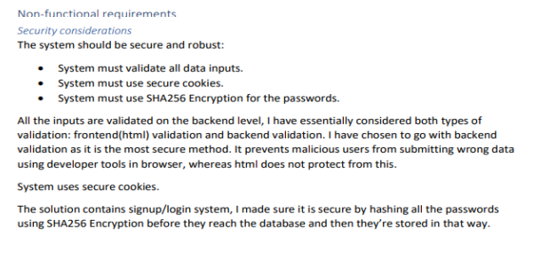
Examiners Comments

Slide 22
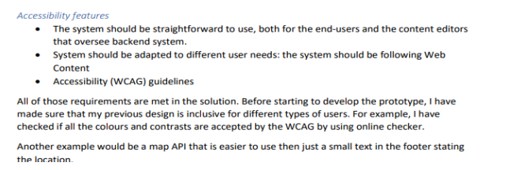
Examiners Comments

Slide 23
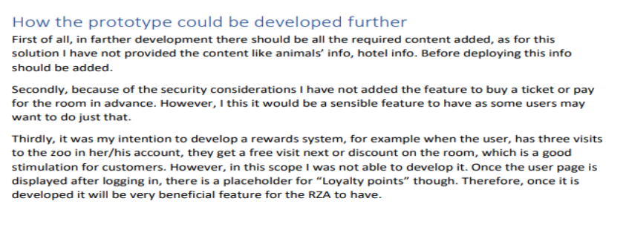
Examiners Comments

Slide 24
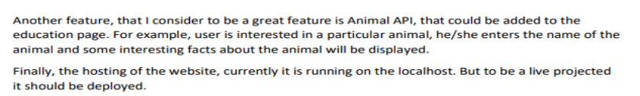
Examiners Comments

Slide 25
Approximate Grade Boundaries
 | Marks | Half marks
Task 1A - Proposal | 24
Task 1B - Designs | 34
Total | 58 | 29
Task 2 – Develop the solution | 48
Total | 48 | 24
Task 3a - feedback | 24
Task 3b - Testing | 15
Total | 39 | 19
Maximum Mark | 145 | 72
 | Grade Boundary
Distinction | 99
Merit | 68
Pass | 38

